Slide 1
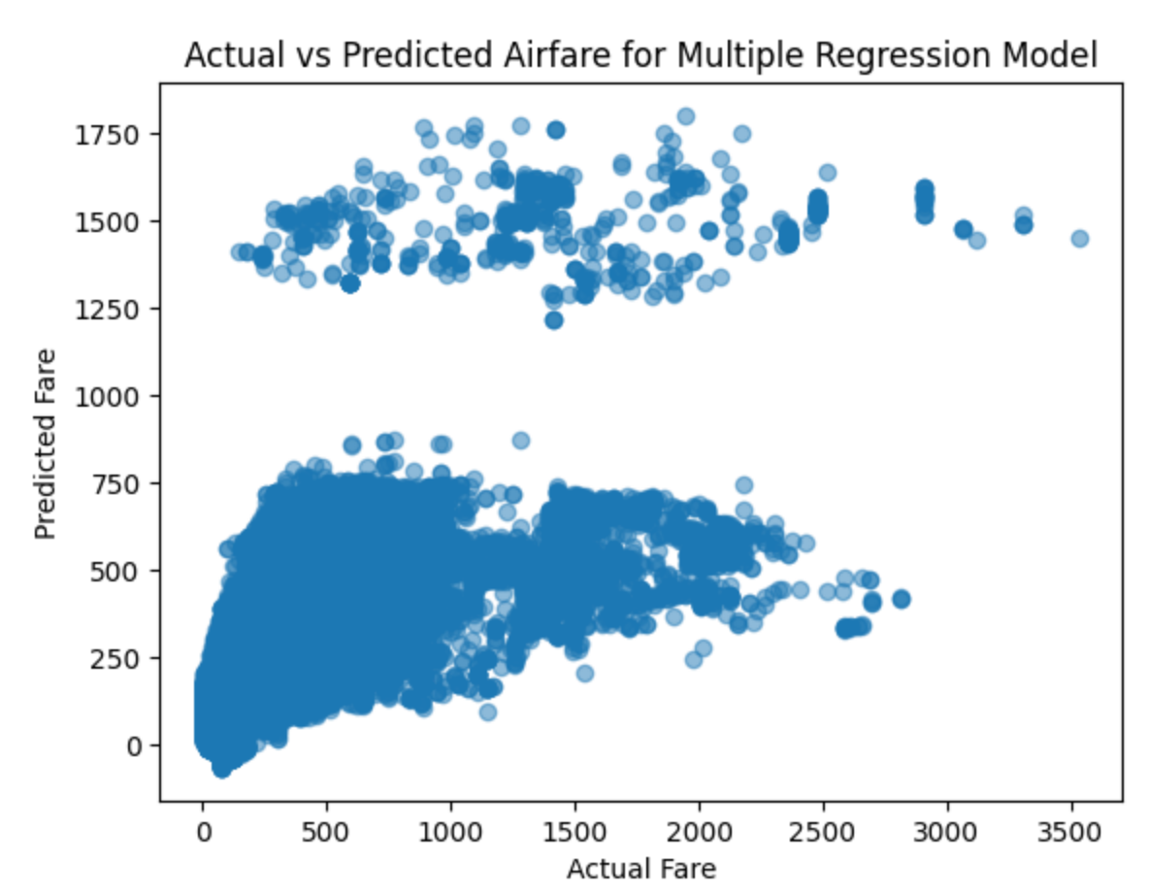
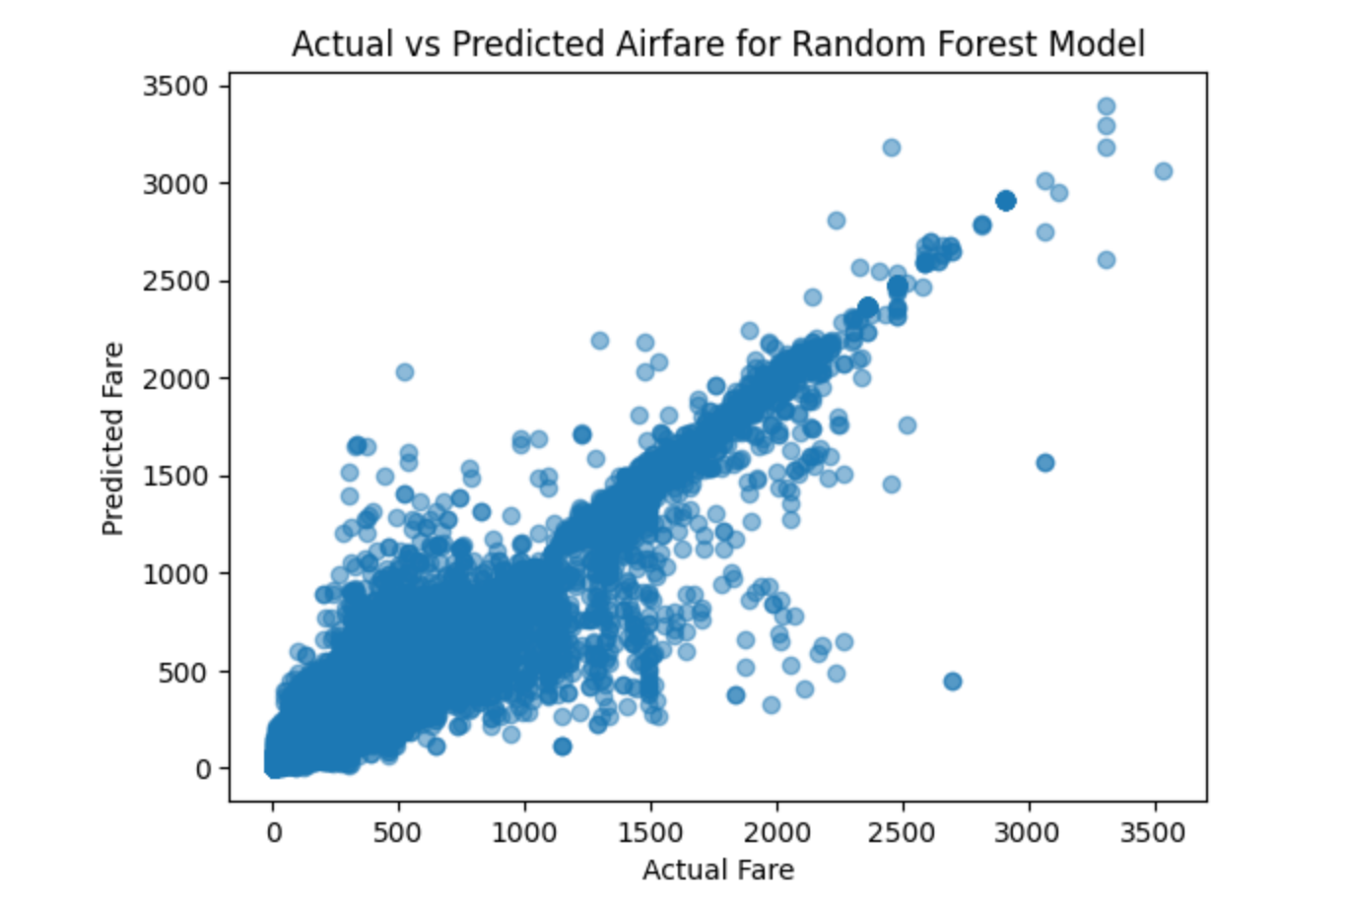
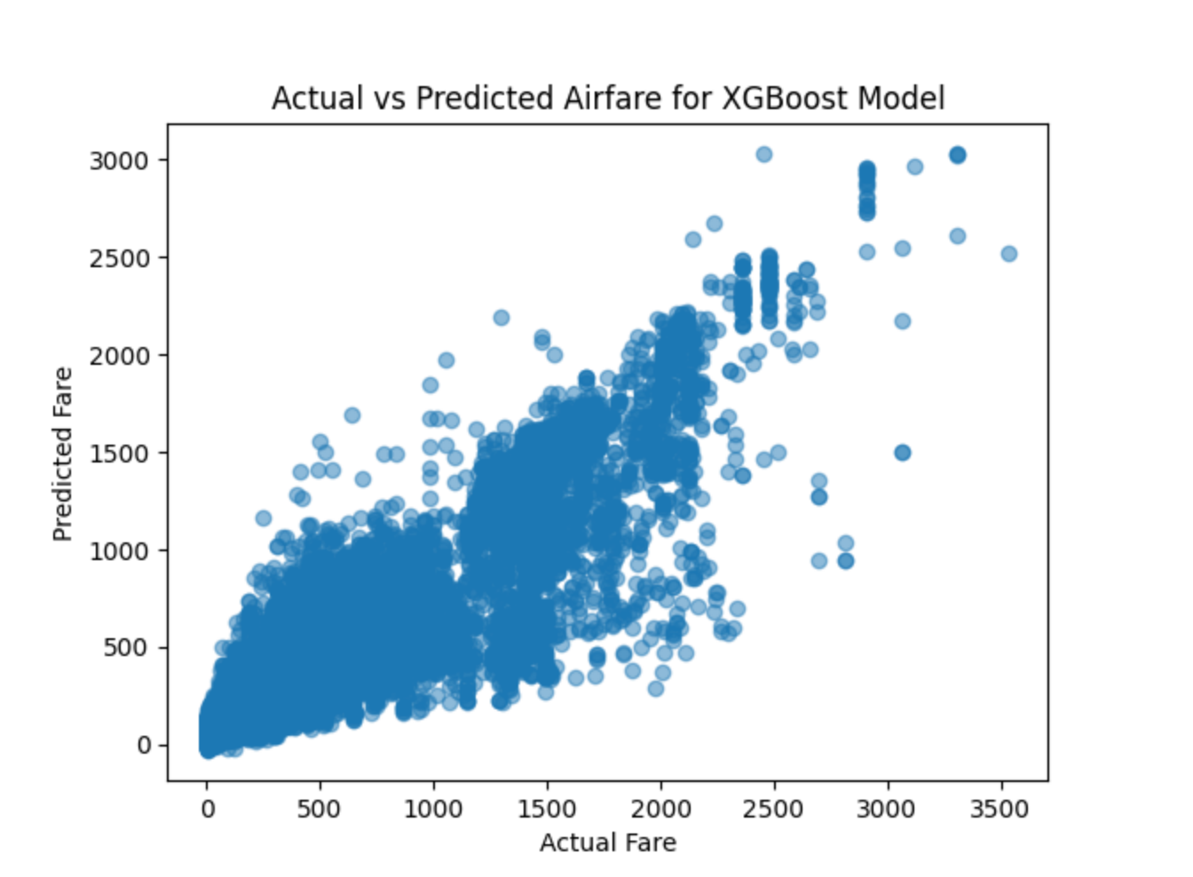
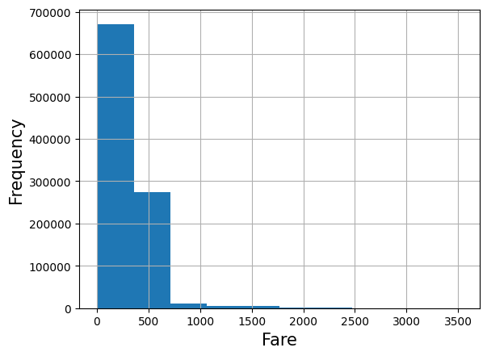
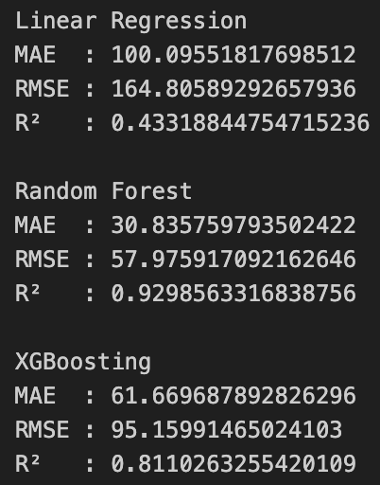
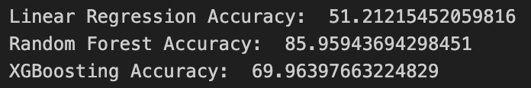
Basic Flight Fare
Prediction System
Members: Subhan Mehmood, Hashirul Quadir, Dionissios Kakissis, Mohammad Bakeer, Abiha Fatima
Goal
OBJECTIVE
RESULTS
Predicting flight ticket prices is a complex task influenced by various dynamic factors such as airline, departure time, travel duration, and flight class. This project presents a machine learning-based system designed to forecast airfare based on user-specified inputs. Using a large dataset of one-way flight prices sourced from Expedia, we conducted extensive data preprocessing and feature engineering to handle missing values, encode categorical variables, and extract relevant features.
The objective of this project is to develop a machine learning-based system capable of accurately predicting flight ticket prices based on user-specified inputs such as origin, destination, travel date, and other flight-related features.
Graph 1. Multiple Linear Regression Model
Graph 2. Random Forest
METHODS
We used the Flight Prices dataset from Kaggle, containing ~6 million one-way Expedia flight records. For efficiency, we worked with the first 1 million entries. Data preprocessing included handling missing values with median imputation, converting durations to seconds, and encoding categorical variables (label encoding for tree-based models, one-hot for linear regression).
Key features were selected through correlation analysis, Extra Trees Regressor, and Recursive Feature Elimination (RFE), identifying variables like totalTravelDistance, travelDuration, and flightDateOrdinal as most impactful.
We trained and compared three models:
Multiple Linear Regression (baseline)
Random Forest (main approach)
XGBoost (oracle model)
All models used a 70/30 train-test split. Evaluation was based on RMSE, MAE, R², and a custom accuracy score based on MAPE. The Random Forest model achieved the best performance and was selected for deployment in our web application.
BACKGROUND
Accurately predicting flight ticket prices poses a significant challenge due to the complex interplay of factors such as airline, travel duration, departure timing, and flight class. Prior work in this domain, such as that of Kunal Dhavale, has demonstrated the viability of using machine learning techniques like Random Forest and XGBoost to estimate airfare based on scraped online data. Building on these foundations, our project expands the scope by leveraging a more comprehensive and feature-rich dataset sourced from Expedia, encompassing nearly six million flight records.
Multiple Linear Regression — The scatter plot shows a wide spread of points and two clusters, indicating inconsistent predictions, especially for high fares. The model tends to overpredict low-cost flights and underpredict expensive ones, revealing its struggle with accurate estimates.
Random Forest — The plot shows that predicted fares closely match actual fares, with most points falling near the 45-degree line, indicating high accuracy. The model generalizes well across price ranges, with few outliers and no distinct clusters, capturing the data’s continuous nature.
XGBoost—The plot shows that XGBoost captures the general airfare trend but with more spread than Random Forest, especially for higher-priced tickets. Predictions for fares above $1000 show greater variance, and prices between $2000 and $3000 are often underpredicted.
Graph 3. XGBoost
CONCLUSIONS
This project successfully demonstrated the use of machine learning models to predict flight ticket prices based on various user-defined features. Among the models tested, the Random Forest model delivered the highest accuracy and consistency, making it the best choice for integration into our web application.
While our results were promising, there remains room for improvement. With additional time and resources, further feature engineering—such as classifying airlines by pricing tiers or incorporating seasonal trends—could enhance predictive performance.
Notes:
Poster designers:
All text (except graphs, tables and other imported media) should be Calibri.
Make text as large as possible for the alloted space, but don’t use too many different font sizes.
Use the minimum text required to make your points.
Use colors in your tables and graphs if possible.
Use appropriate graphics to punch up your presentation.

